Slide 1
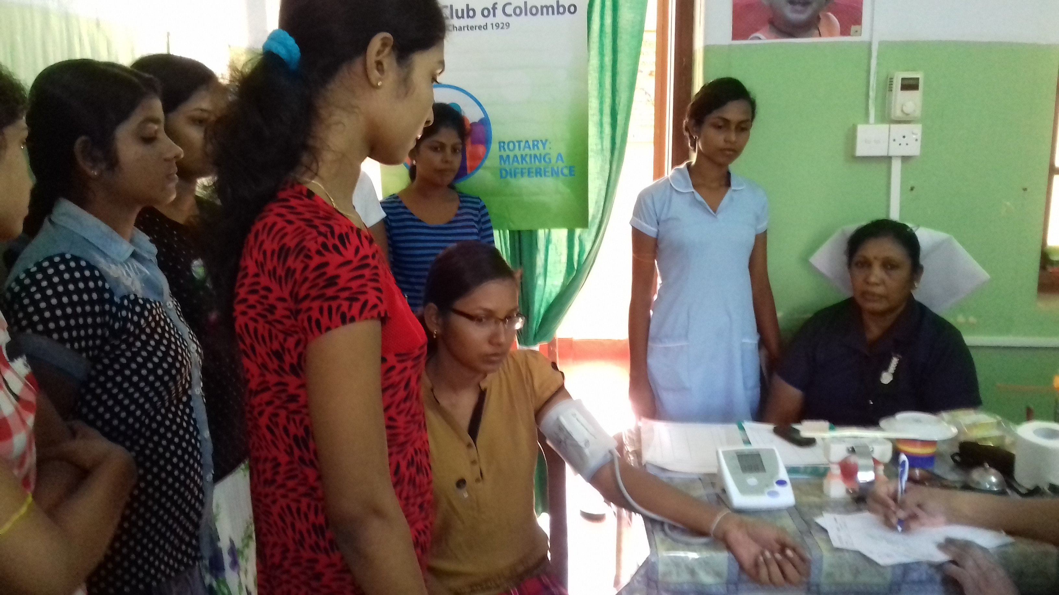

Slide 2
Treating the trainee nurse at the GMH

Slide 3
Treatment being carried out

Slide 4
Free clinic at the GMH

Slide 5
Treating wheel chair patient

Slide 6
Blood pressure being taken and advice being given

Slide 7
Priest from CSI being treated

Slide 8
Treatment being carried out

Slide 9
Treating wheel chair patient.

Slide 10
Check ups done and treatment being carried out

Slide 11
Friday prayars at the GMH before clinic

